Slide 1


Homework Exercise 02
Geodetic Earth Observation, WS 2022/23
Christopher Mahn, Silas Teske, Joshua Wolf

Slide 2
Structure of the presentation
Introduction
Data processing
Selection of a region of interest
Pre-processing the monthly solutions
Calculation of unfiltered equivalent water heights (EWH)
Filtering of the spherical harmonic coefficients
Computation of a time series of region averages
Interpolation of missing GRACE months
Estimation of linear mass trend
Results and discussion
Conclusion and perspective
Bibliography
Christopher Mahn, Silas Teske, Joshua Wolf

Slide 3
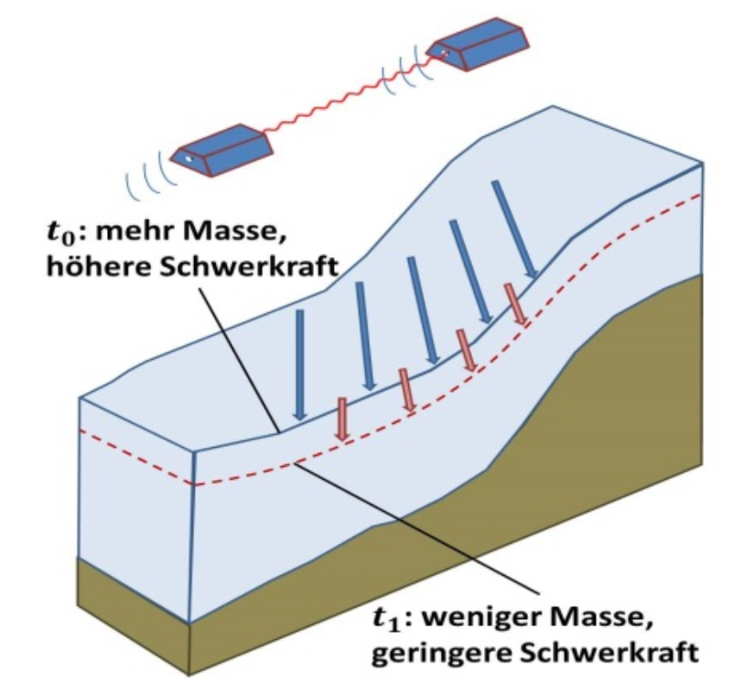
1. Introduction
The continental mass balance changes constantly
Seasonal changes
Changes due to global warming
Changes due to other human activity
These mass changes can be observed using 3 methods
input-output method
volumetric method
gravimetric method
Mass changes can be observed using gravimetric methods
t0 = more mass = higher gravitational force
t1 = less mass = lower gravitational force
Eicker (2022)
Christopher Mahn, Silas Teske, Joshua Wolf

Slide 4
1. Introduction
Necessary steps while processing the data:
Removal of the static gravity field
Calculation of unfiltered equivalent water heights
Using the load love numbers for approximating the glacial isostatic adjustment (GIA)
Filtering of the spherical harmonic coefficients
Gaussian filter with various filter radii choose one
Computation of a time series of region averages
Interpolation of missing GRACE months by inserting the average of the previous and the successive mean EWH
Estimation of linear mass trend of the interpolated series
Christopher Mahn, Silas Teske, Joshua Wolf

Slide 5
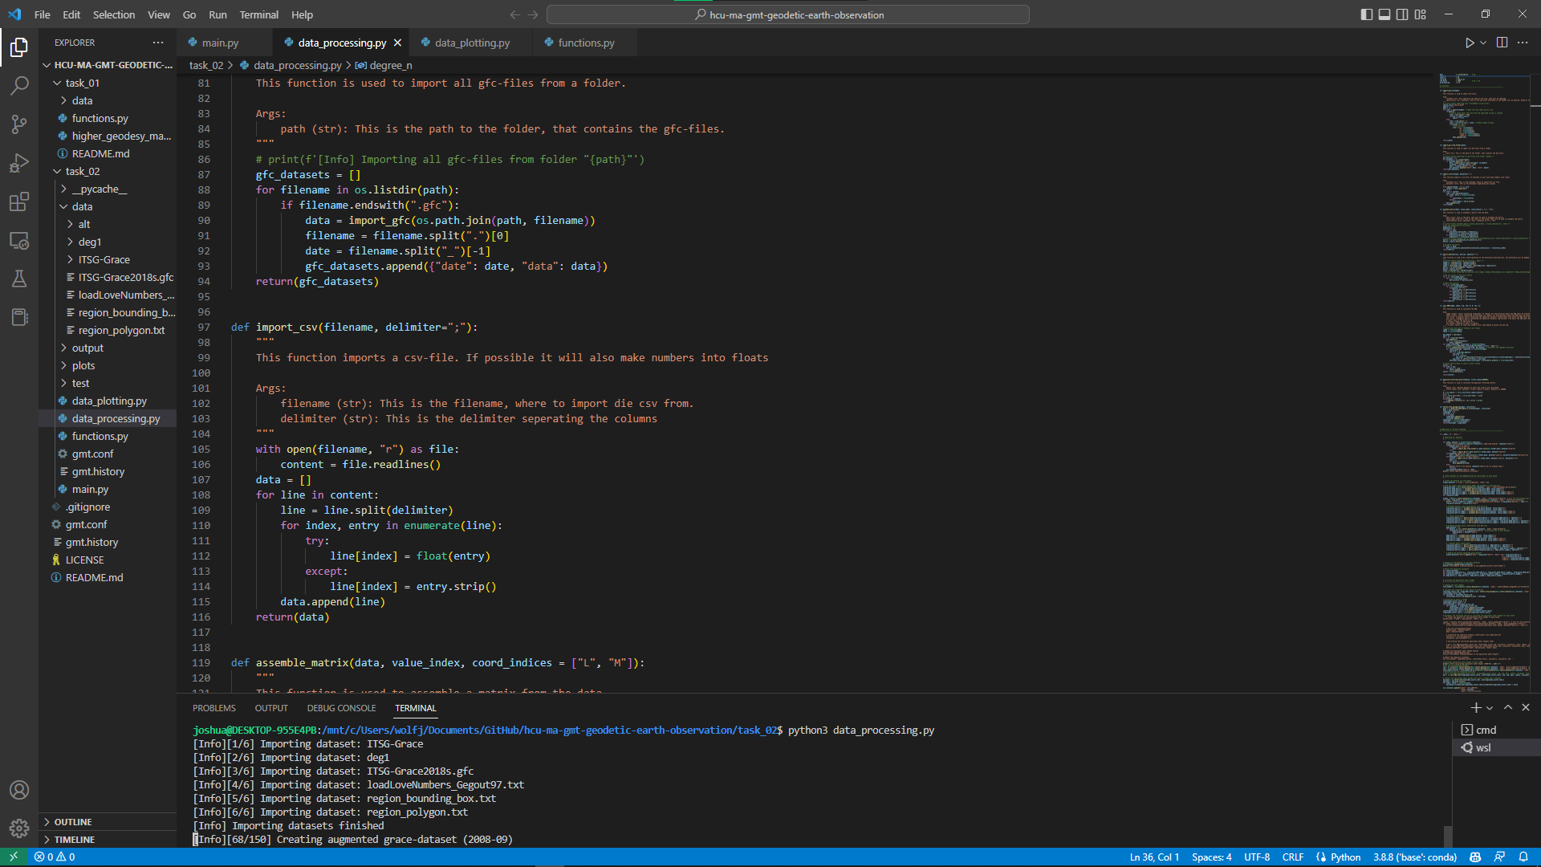
2. Data processing
Python scripts and a library for different sub-tasks:
main.py
data_processing.py
functions.py
data_plotting.py
Christopher Mahn, Silas Teske, Joshua Wolf

Slide 6
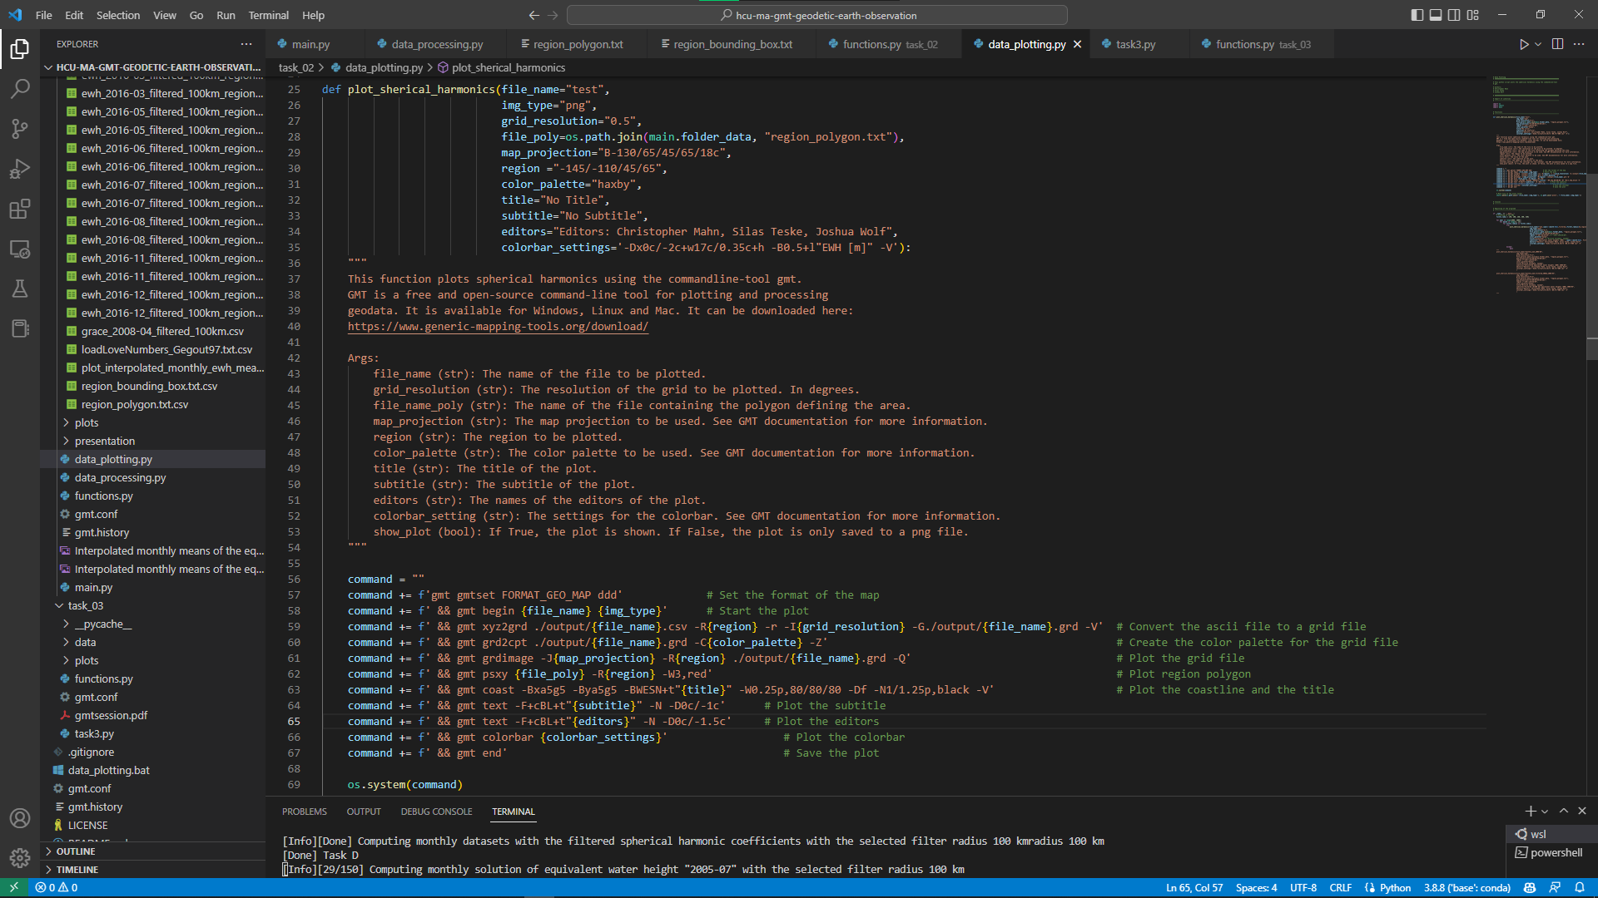
2. Data processing
Python scripts and a library for different sub-tasks:
main.py
data_processing.py
functions.py
data_plotting.py
Christopher Mahn, Silas Teske, Joshua Wolf

Slide 7
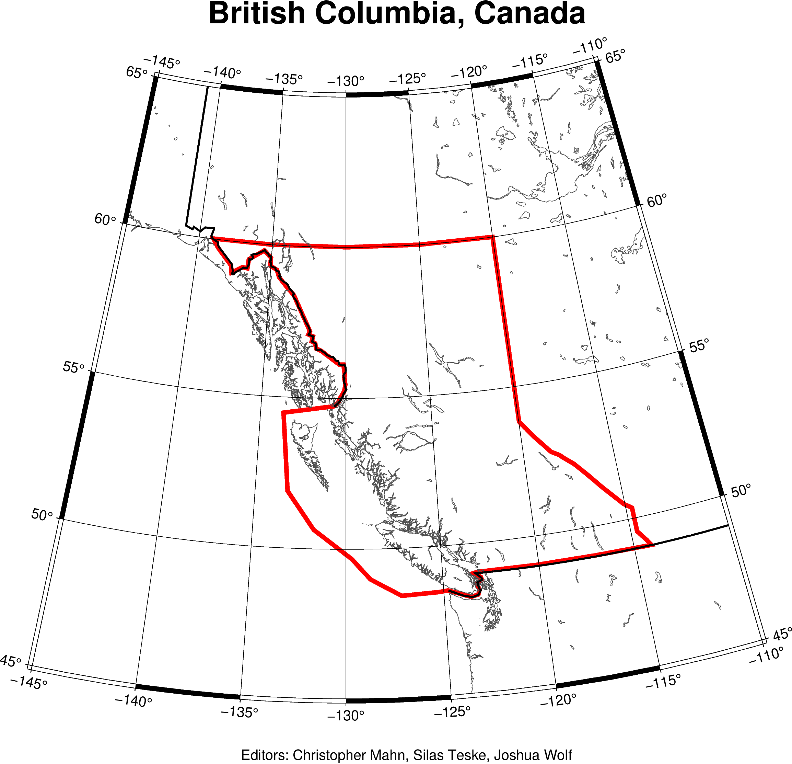
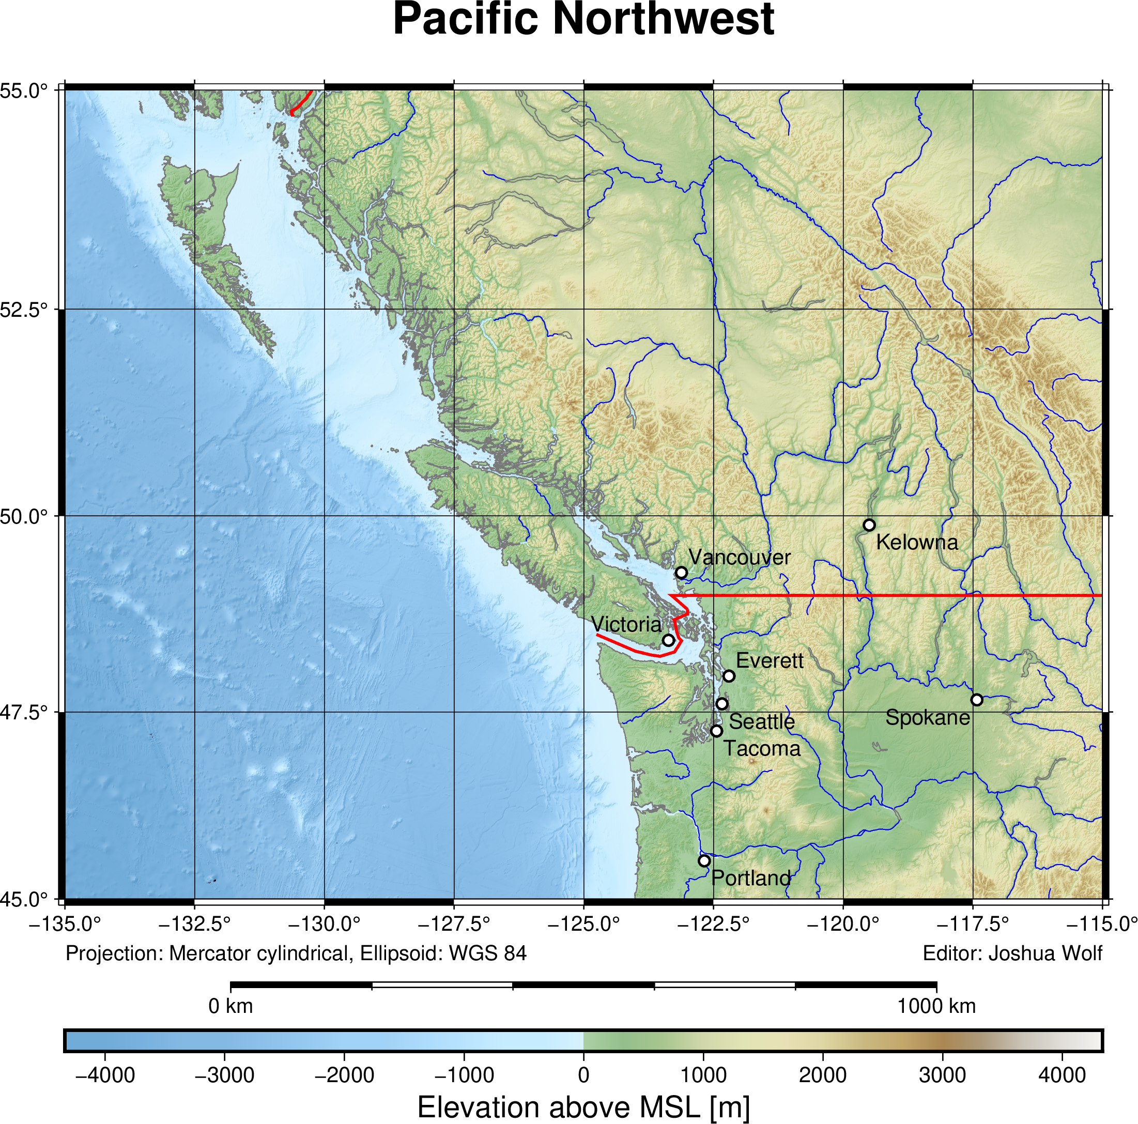
a) Selection of a region of interest
Canadian Province of British Columbia

Slide 8
b) Pre-processing the monthly solutions
Removed the static gravity field ITSG-Grace2018s.gfc
Added the monthly grace coefficients
Christopher Mahn, Silas Teske, Joshua Wolf

Slide 9
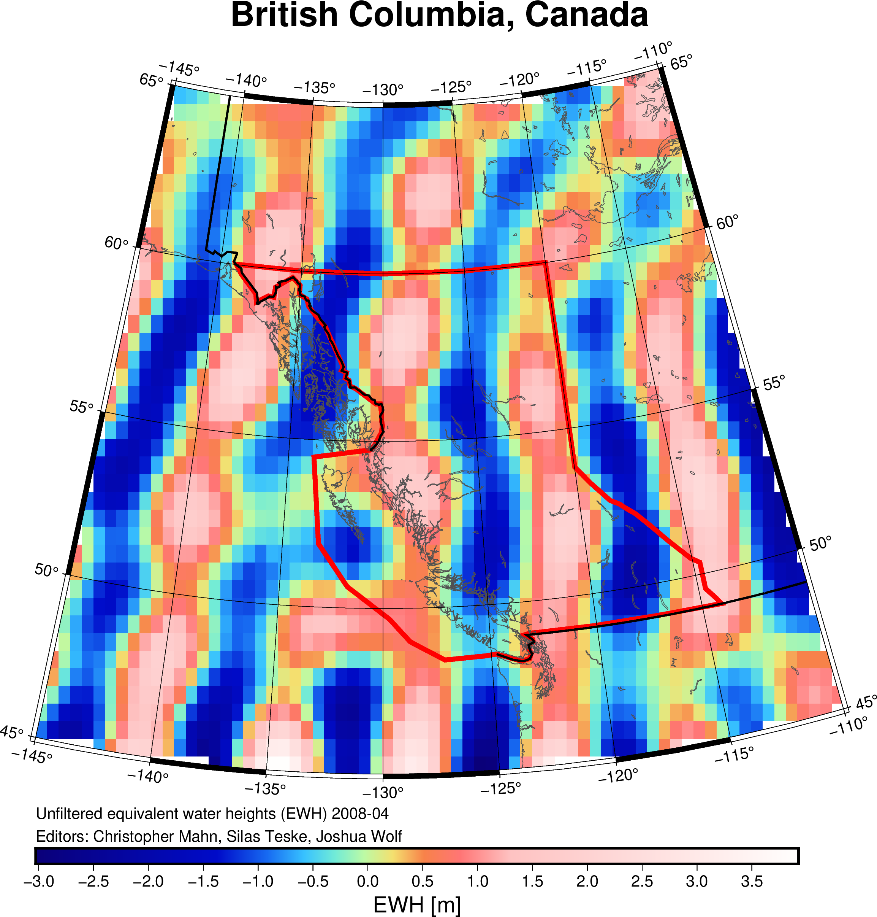
c) Calculation of unfiltered EWH
Strong noise in unfiltered data
Christopher Mahn, Silas Teske, Joshua Wolf

Slide 10
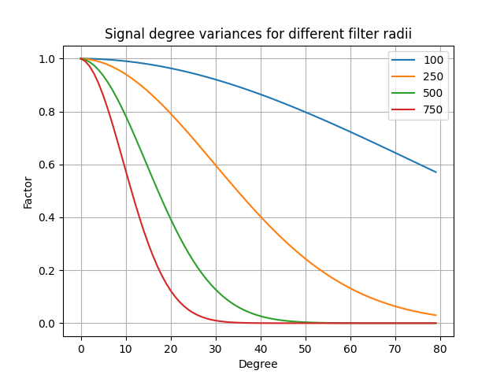
d) Filtering of the spherical harmonic coefficients
Choosing the optimal filter radius
Christopher Mahn, Silas Teske, Joshua Wolf

Slide 11
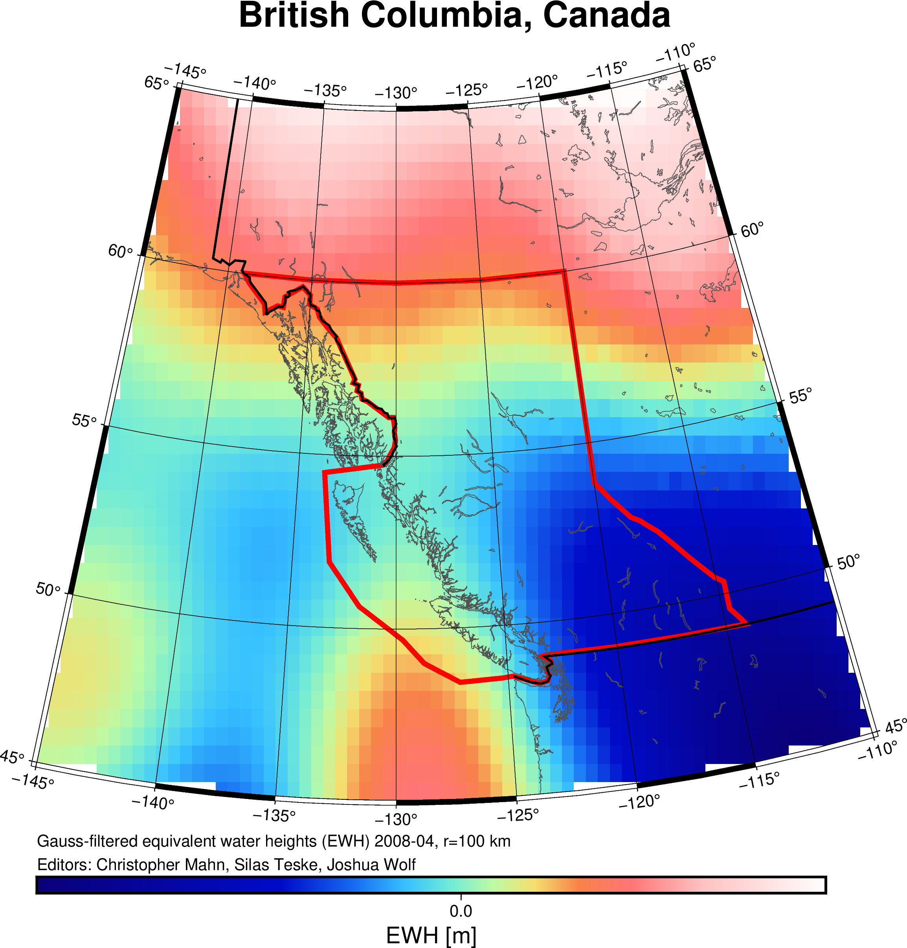
d) Filtering of the spherical harmonic coefficients
r = 100 km
Christopher Mahn, Silas Teske, Joshua Wolf

Slide 12
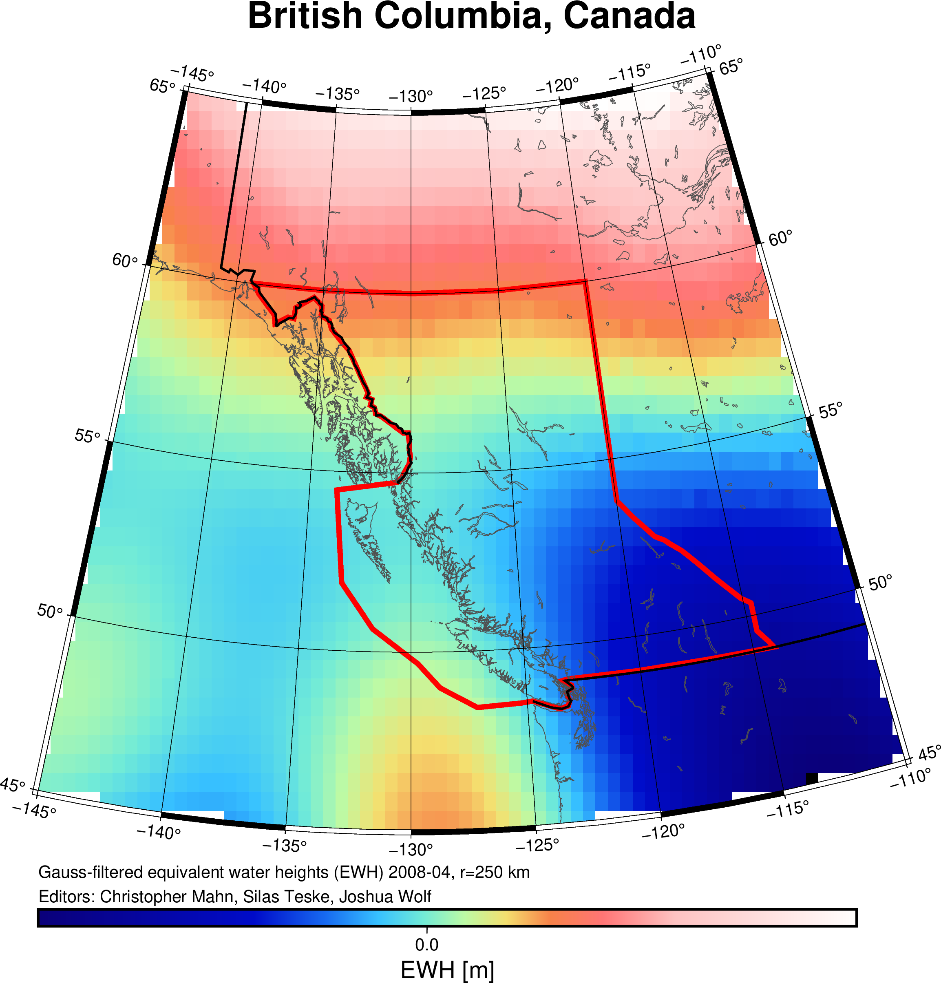
d) Filtering of the spherical harmonic coefficients
r = 250 km
Christopher Mahn, Silas Teske, Joshua Wolf

Slide 13
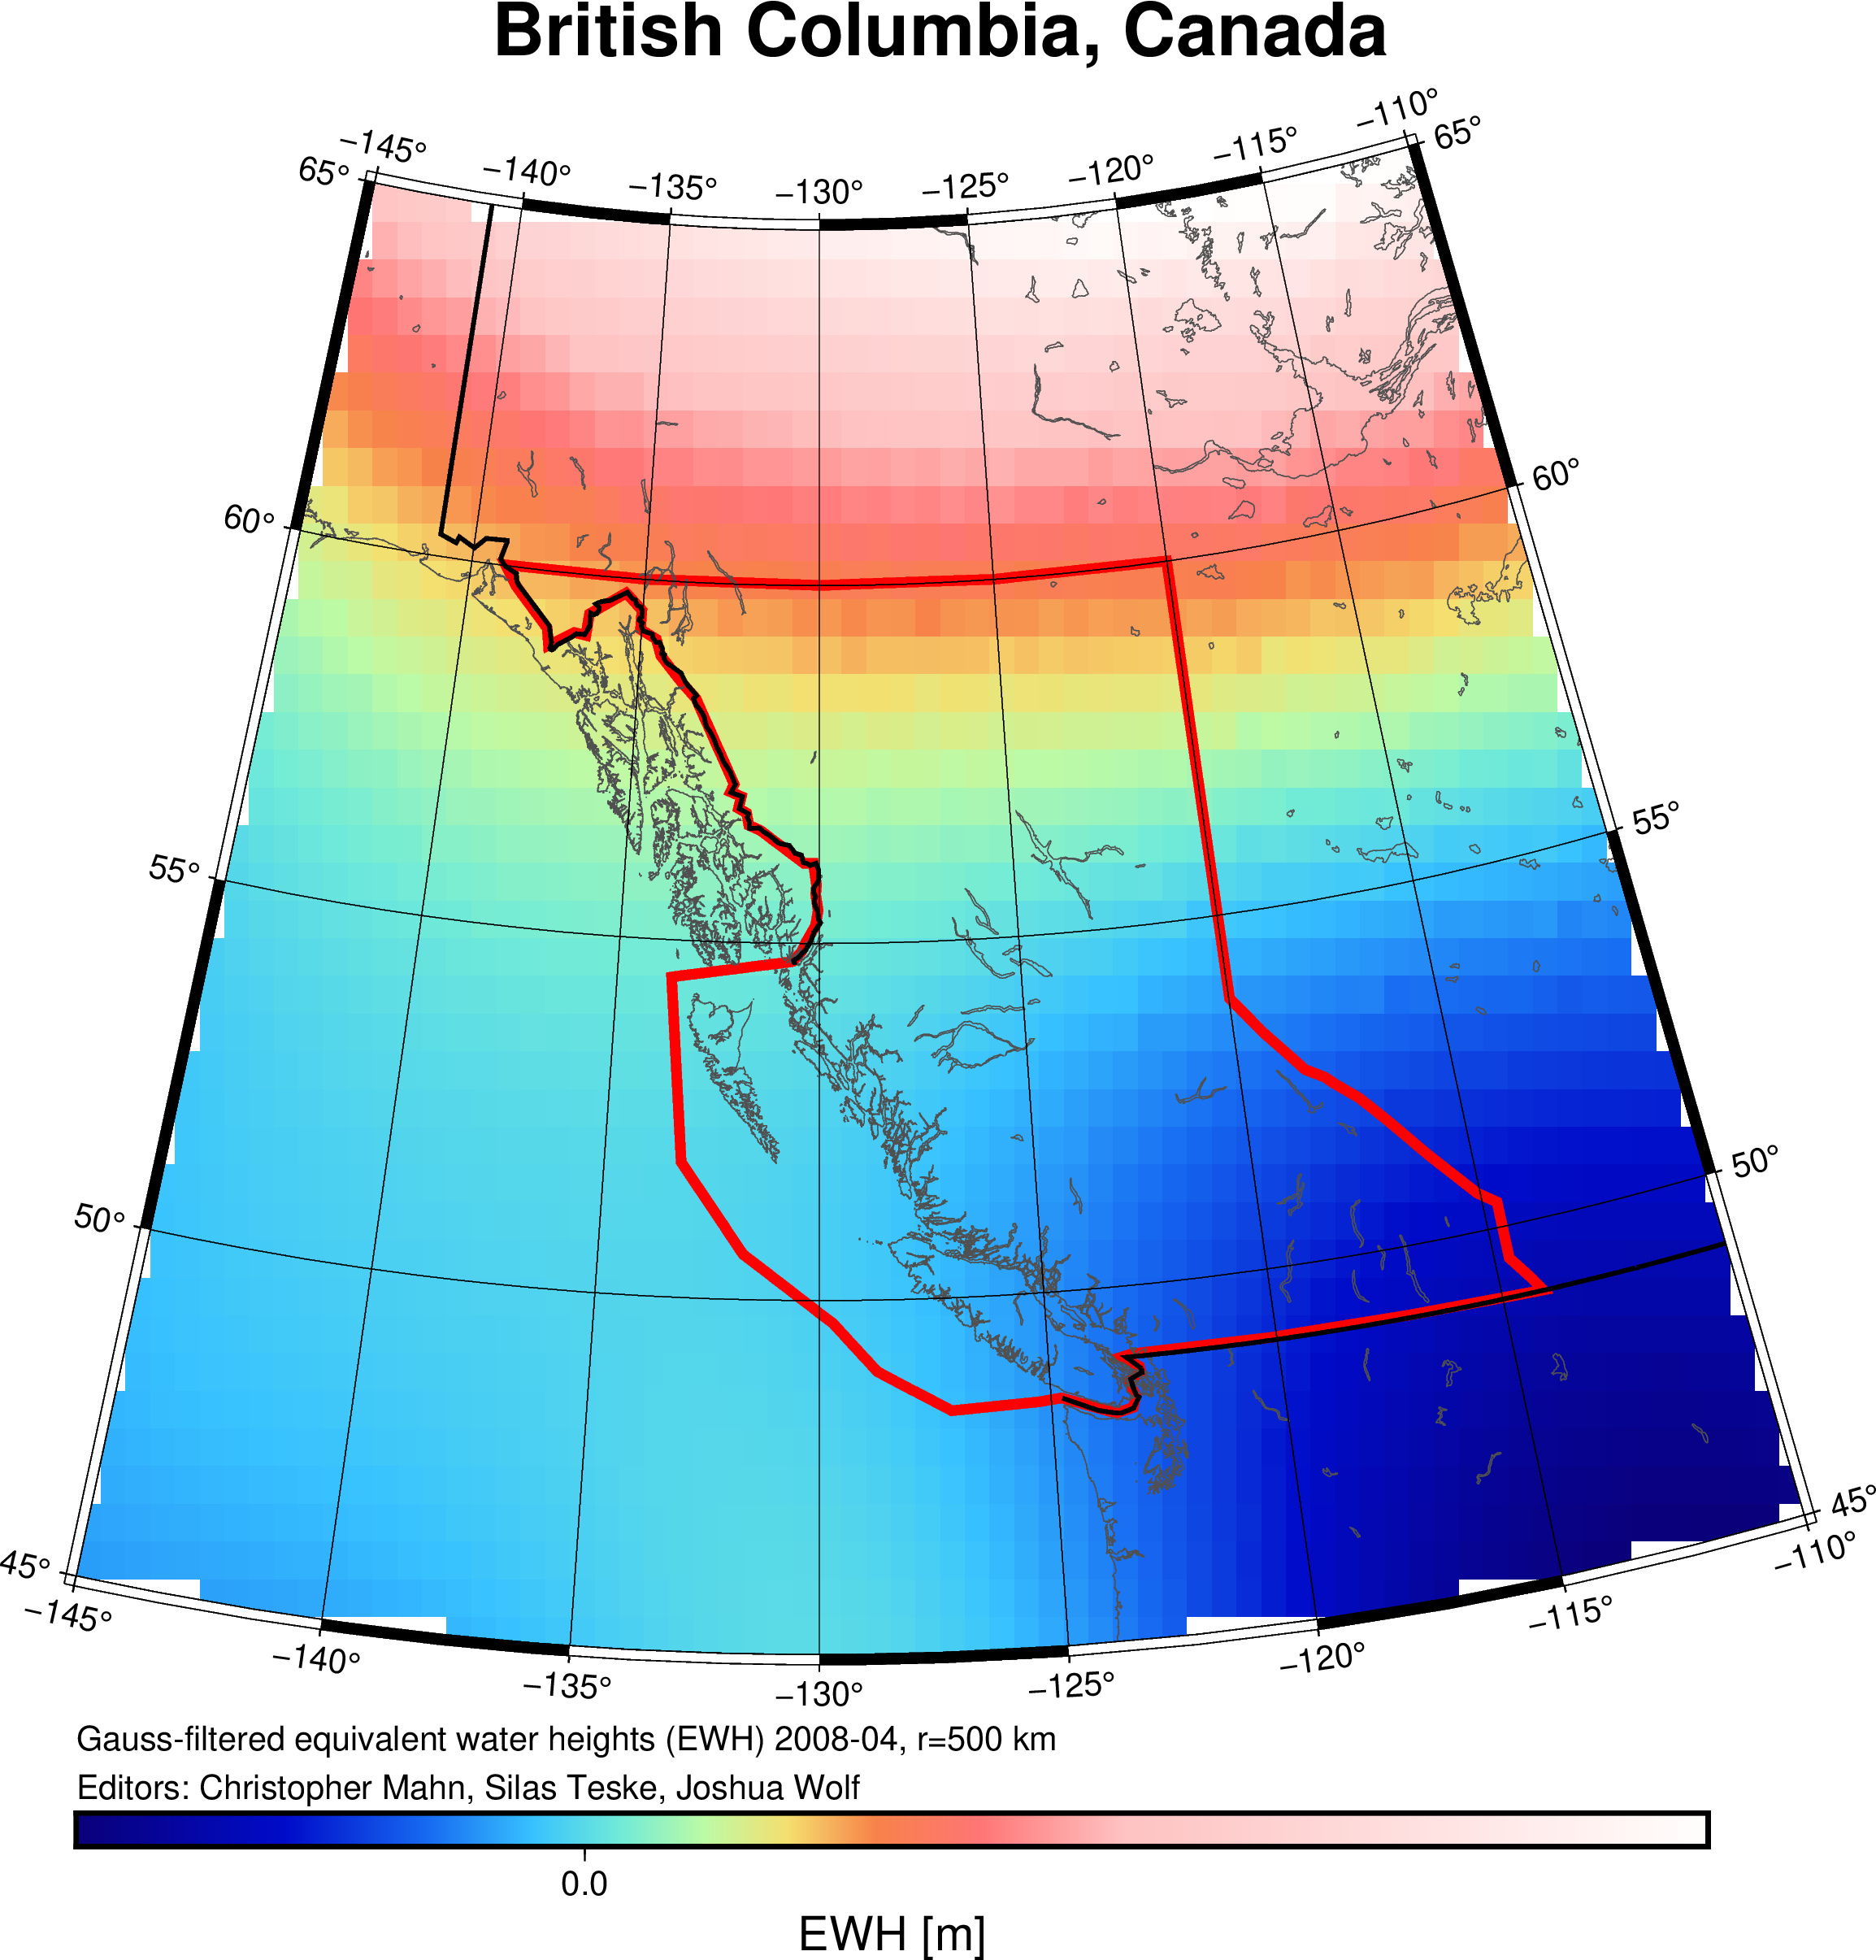
d) Filtering of the spherical harmonic coefficients
r = 500 km
Christopher Mahn, Silas Teske, Joshua Wolf

Slide 14
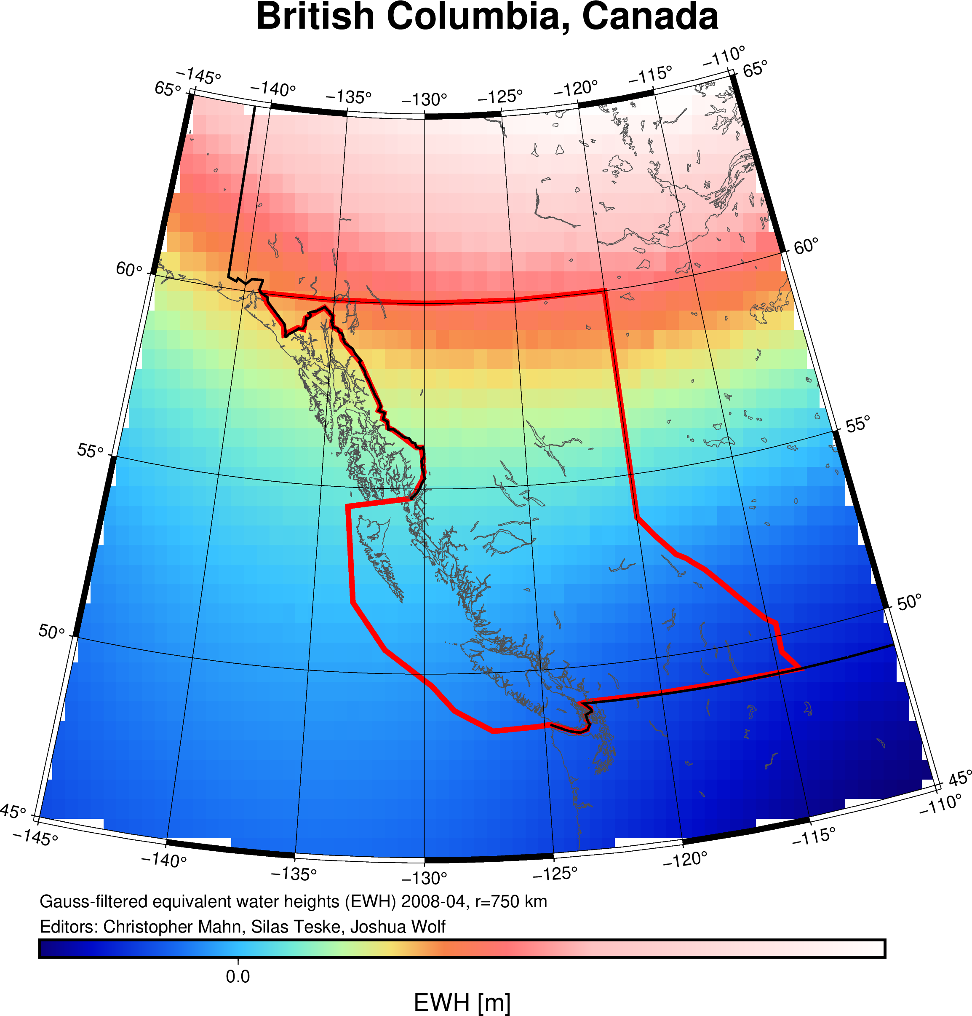
d) Filtering of the spherical harmonic coefficients
r = 750 km
Christopher Mahn, Silas Teske, Joshua Wolf

Slide 15
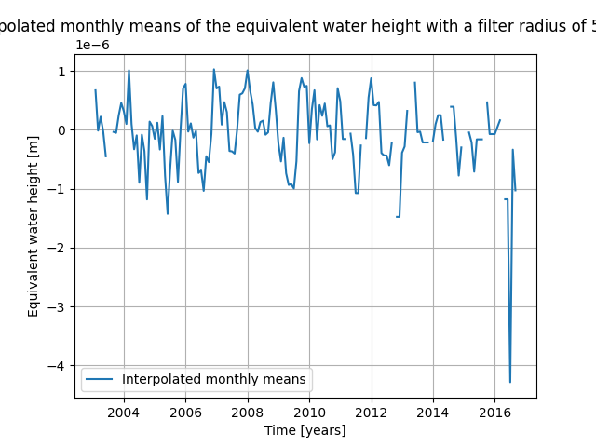
e) Computation of a time series of region averages
EWH time-series for the region average defined by the polygon
Missing months because of GRACE shut-off
Christopher Mahn, Silas Teske, Joshua Wolf

Slide 16

f) Interpolation of missing GRACE months
Interpolation by inserting the average of the previous and the successive mean equivalent water height
Christopher Mahn, Silas Teske, Joshua Wolf

Slide 17
g) Estimation of linear mass trend
The linear trend of the equivalent water heights we calculated for the province of British Columbia:
NaN Gt/yr
Christopher Mahn, Silas Teske, Joshua Wolf

Slide 18
3. Results and discussion
Zu
Christopher Mahn, Silas Teske, Joshua Wolf

Slide 19
4. Conclusion and perspective
P
Christopher Mahn, Silas Teske, Joshua Wolf

